Slide 1


Next Up:
Jess Pomfret & Rob Sewell
Next Level PowerShell Development
with Dev Containers and GitHub Codespaces

Slide 2
3
3

Slide 3
2

Slide 4
1

Slide 5

The Ideal Environment for Crafting PowerShell Scripts
Jess Pomfret & Rob Sewell
Streamline your workflow with Dev Containers and GitHub Codespaces.
Notes:
Welcome to our presentation on the ideal environment for crafting PowerShell scripts. Our focus will be on Dev Containers and GitHub Codespaces, two powerful tools that can streamline your workflow and make development accessible to everyone.
This is Jess!

Slide 6




Jess Pomfret (She/Her)
Data Platform Engineer
Open Source Contributor
Passionate about SQL Server, PowerShell & Proper Football
jesspomfret.com
jpomfret7@gmail.com
linkedin.com/in/jpomfret/

Slide 7


Rob Sewell (He/Him)
Beard Twizzler
Open Source Maintainer
Passionate about Automation, Data, Infrastructure & Proper Football, Cricket
robsewell.com
linkedin.com/in/robmsewell/

Slide 8


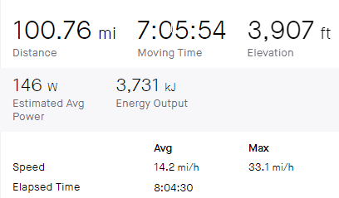




Slide 9

VS Code is Your Best Workspace
Your code editor should work for you, not against you.
Notes:
Jess
VSCode is a powerful, flexible, customizable environment – you can make it perfect for whatever you want and need – for any language you might be writing in here
Extensions for everything
Settings
Trimming whitespace
Configure tabs or spaces
Auto save options – delay, on focus change
VS Code provides a flexible and customizable environment to work in, with a wide range of extensions and settings to optimize your workflow. With VS Code, you can easily navigate and edit your code, debug your applications, and collaborate with your team. Use the integrated terminal to work with command-line tools and execute scripts. With an intuitive UI and advanced features, VS Code is the perfect workspace for developers.

Slide 10
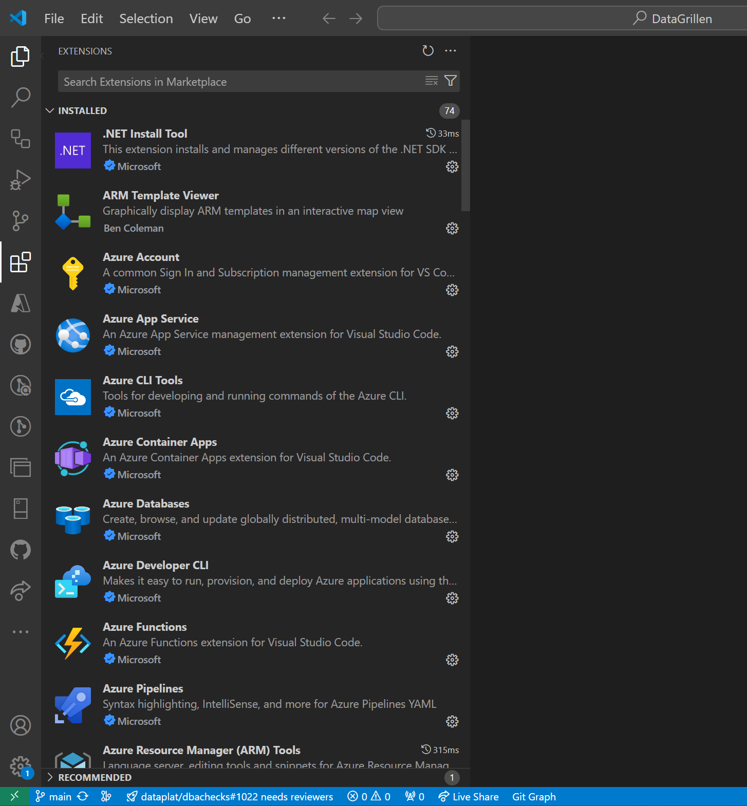
Does Your Workspace Look Like This ?
Notes:
Jess
But with all those settings and extensions, things can get a little messy
VS Code provides a flexible and customizable environment to work in, with a wide range of extensions and settings to optimize your workflow. With VS Code, you can easily navigate and edit your code, debug your applications, and collaborate with your team. Use the integrated terminal to work with command-line tools and execute scripts. With an intuitive UI and advanced features, VS Code is the perfect workspace for developers.

Slide 11
Does Your Workspace Look Like This ?
Notes:
Jess
Rob... you don't know anyones VSCode that looks like this do you?....
VS Code provides a flexible and customizable environment to work in, with a wide range of extensions and settings to optimize your workflow. With VS Code, you can easily navigate and edit your code, debug your applications, and collaborate with your team. Use the integrated terminal to work with command-line tools and execute scripts. With an intuitive UI and advanced features, VS Code is the perfect workspace for developers.

Slide 12
Does Your Workspace Look Like This ?
Notes:
Jess
VS Code provides a flexible and customizable environment to work in, with a wide range of extensions and settings to optimize your workflow. With VS Code, you can easily navigate and edit your code, debug your applications, and collaborate with your team. Use the integrated terminal to work with command-line tools and execute scripts. With an intuitive UI and advanced features, VS Code is the perfect workspace for developers.

Slide 13
Does Your Workspace Look Like This ?
Notes:
Jess
VS Code provides a flexible and customizable environment to work in, with a wide range of extensions and settings to optimize your workflow. With VS Code, you can easily navigate and edit your code, debug your applications, and collaborate with your team. Use the integrated terminal to work with command-line tools and execute scripts. With an intuitive UI and advanced features, VS Code is the perfect workspace for developers.

Slide 14

Every project requires a different set up
Notes:
Rob go into this one

Slide 15

It’s harder to work in a messy workspace

Slide 16

Works on my machine but not on theirs
Notes:
Not just how code works but also spelling, save and format, white space things

Slide 17

Dev Containers: Simplifying Your Workflow

Slide 18
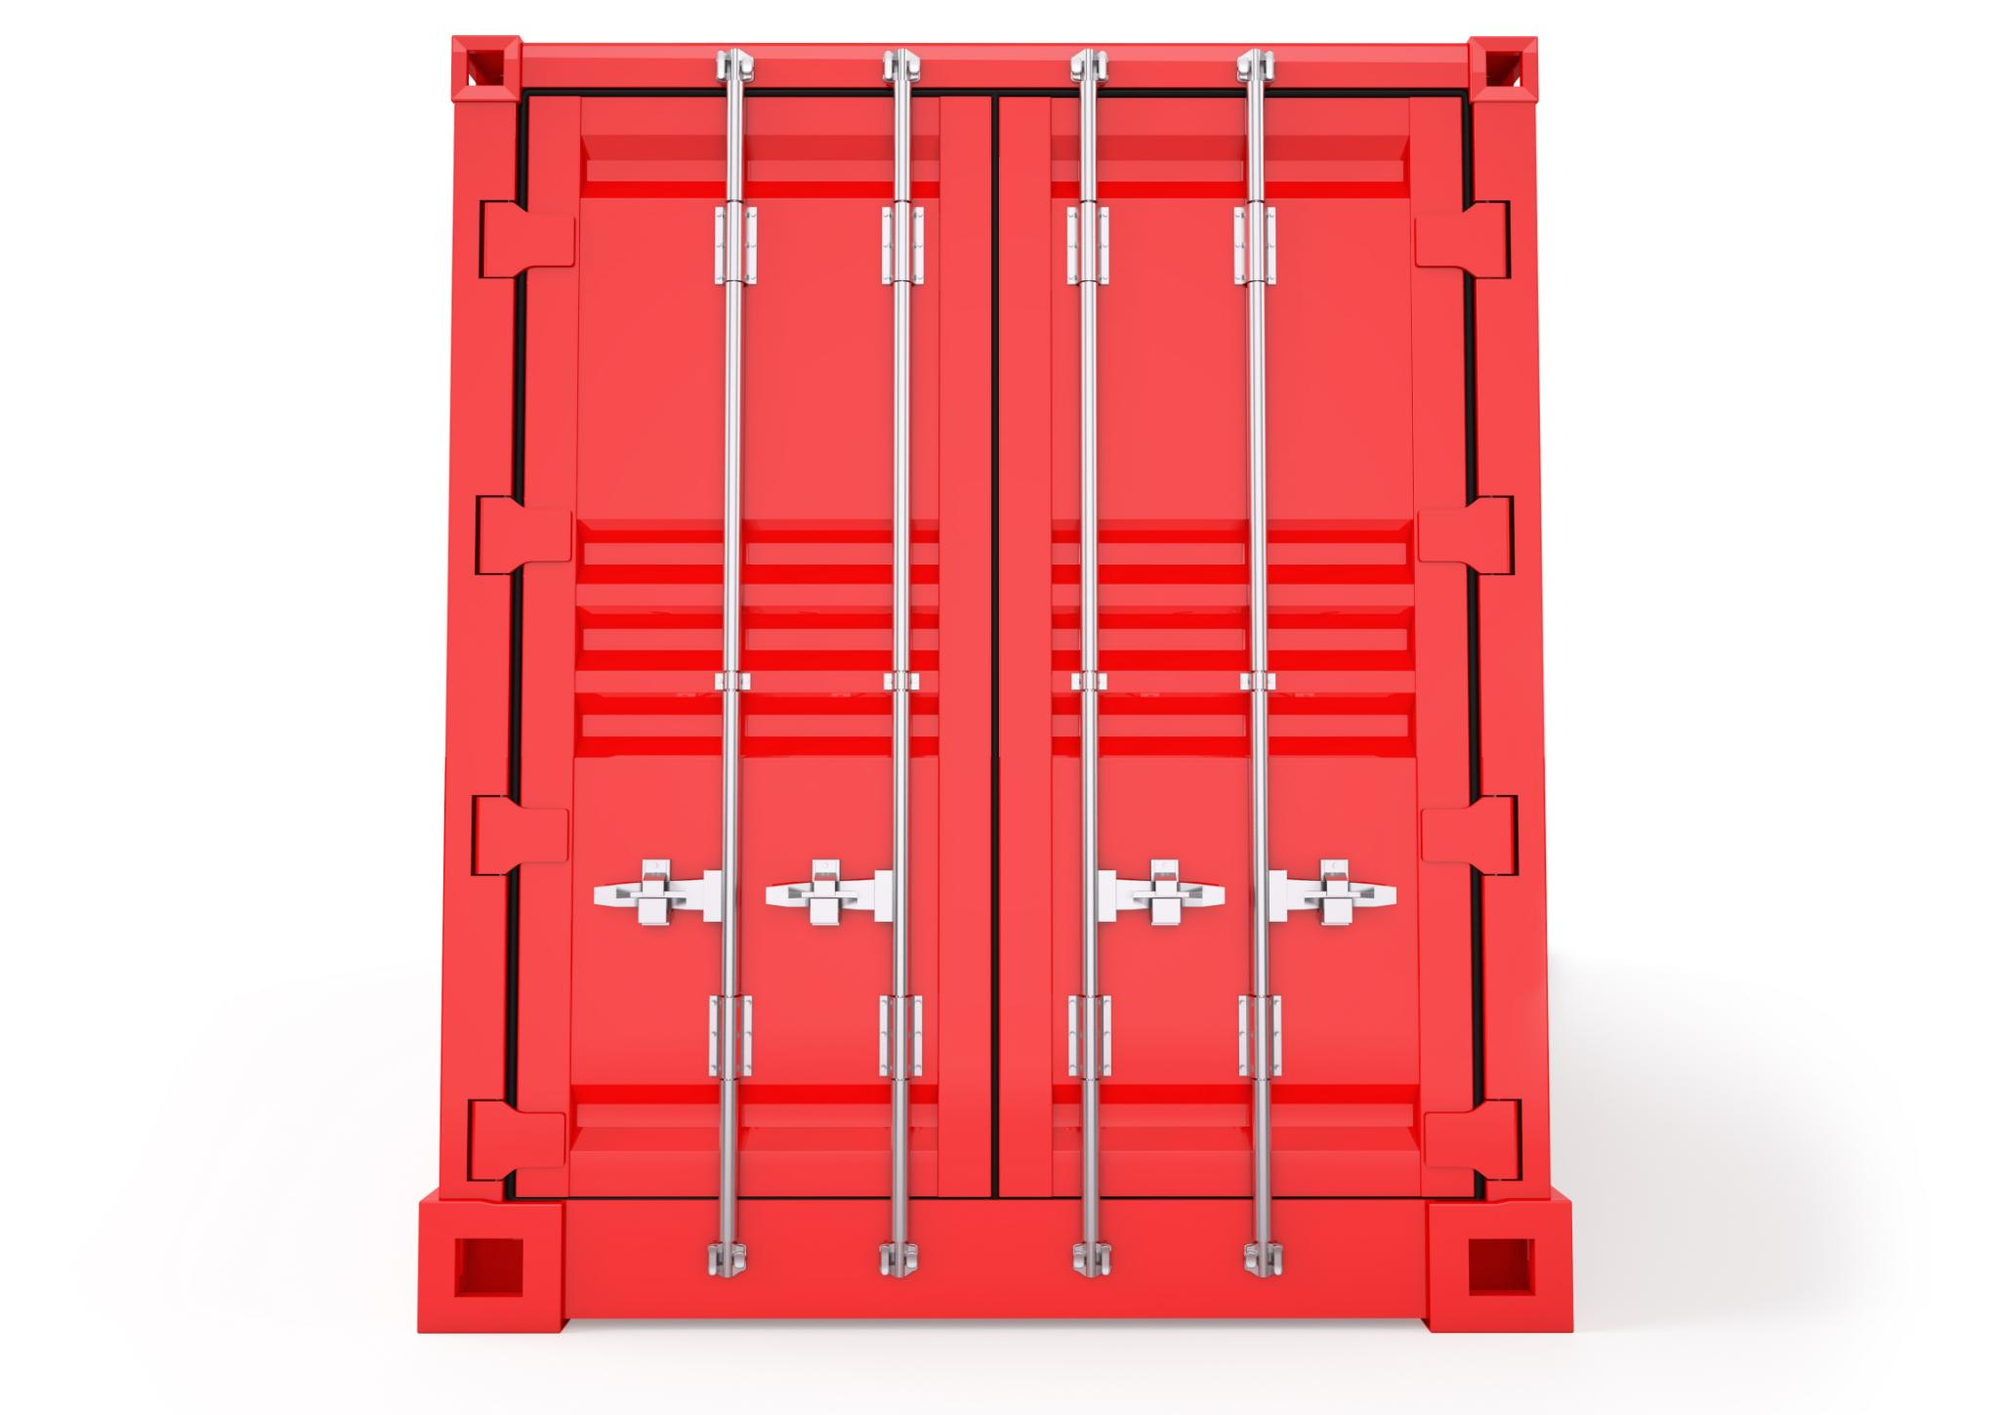
What is a Dev Container?
A Dev Container is a highly portable development environment that can be easily moved across teams and projects, ensuring consistency and efficiency.
Notes:
A Dev Container is a lightweight, portable, and reproducible development environment that can be used across teams and projects. It is a container-based approach to development that ensures consistency and eliminates the need for complex setup instructions.

Slide 19
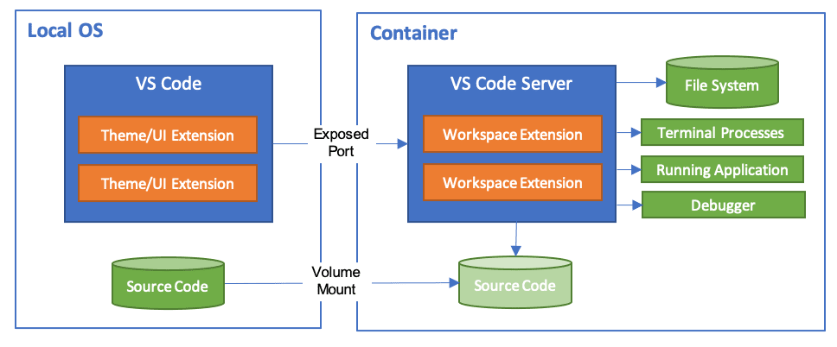
Anatomy of a Dev Container
Notes:
Jess
Developing inside a Container using Visual Studio Code Remote Development
using containers as a full-featured development environment
open your folder of source code mounted into a container
workspace files are mounted to the local file system within the container
VSCode extensions are installed and run within the container
we need three things to use this
1. docker desktop - or an alternative docker option (podman)
2. VSCode or VSCode insiders
3. Dev containers extension

Slide 20
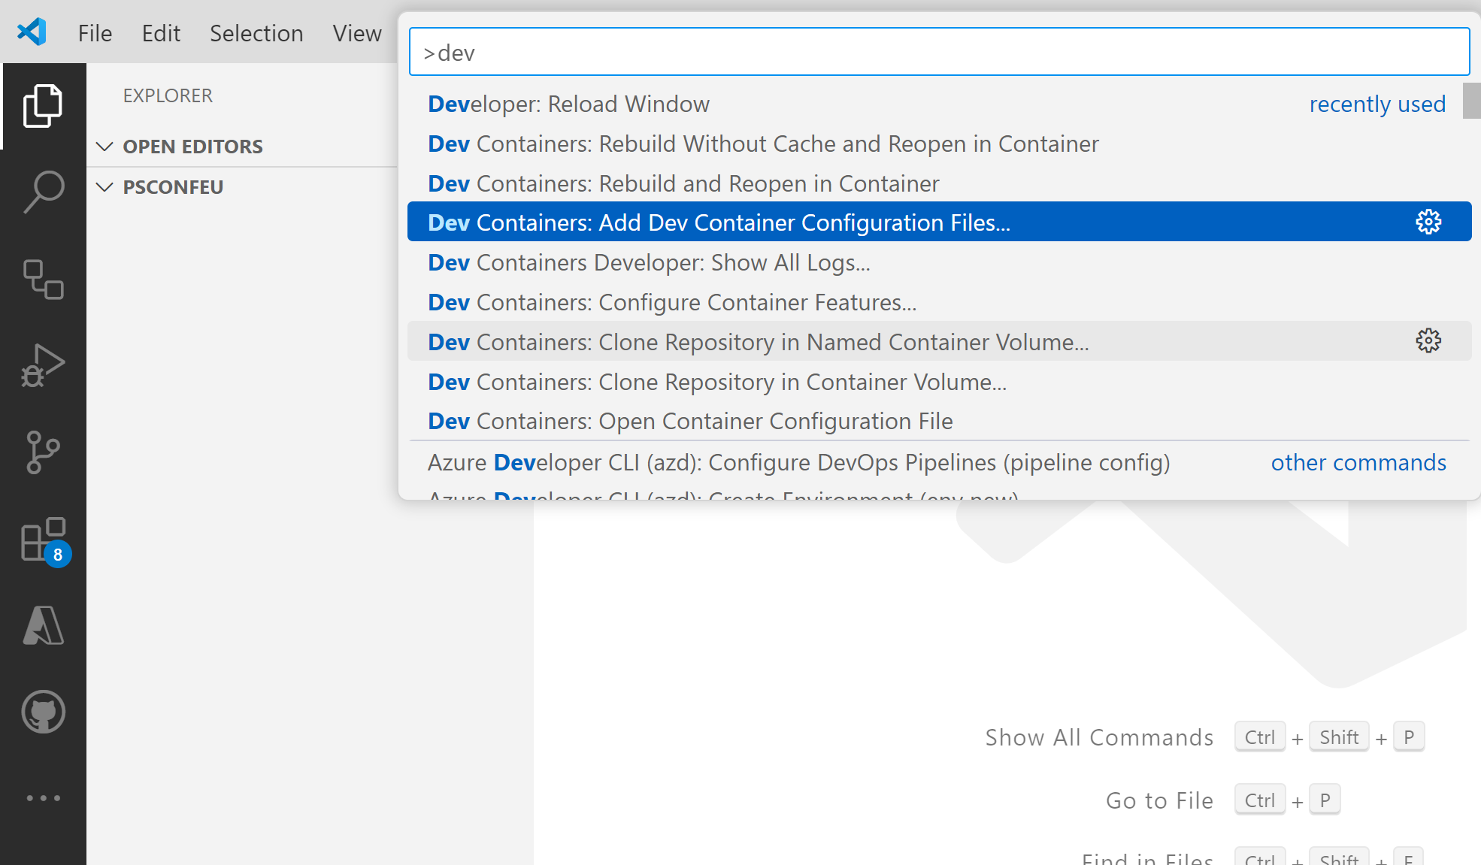

Slide 21
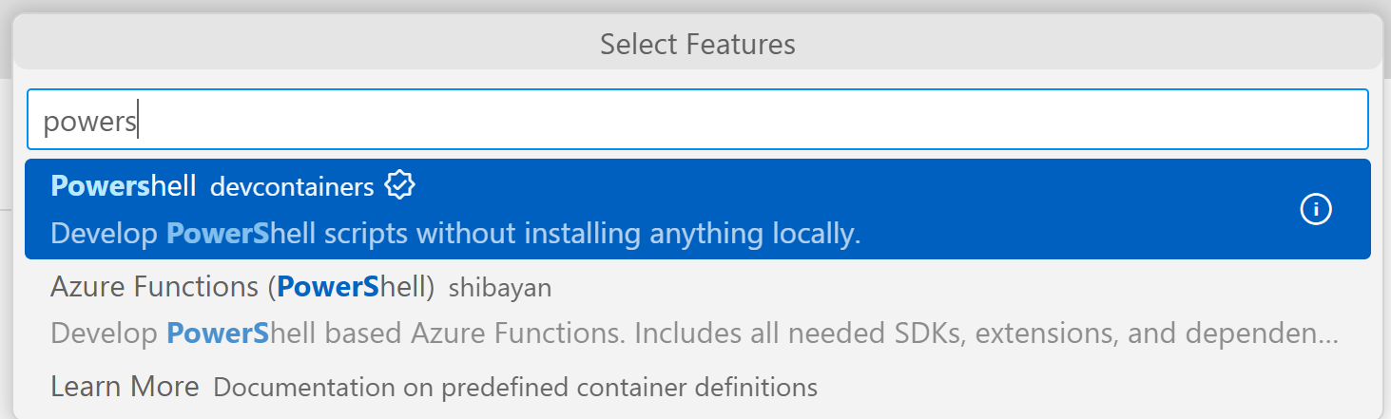

Slide 22

Notes:
For docker it “should” just work If you have Podman you may have fun but update all the things and open the folder in WSL first

Slide 23
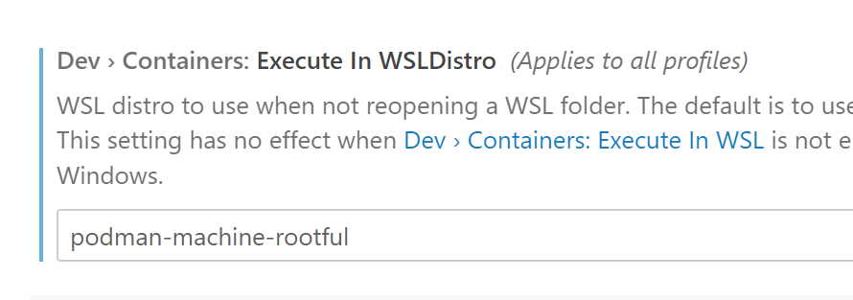
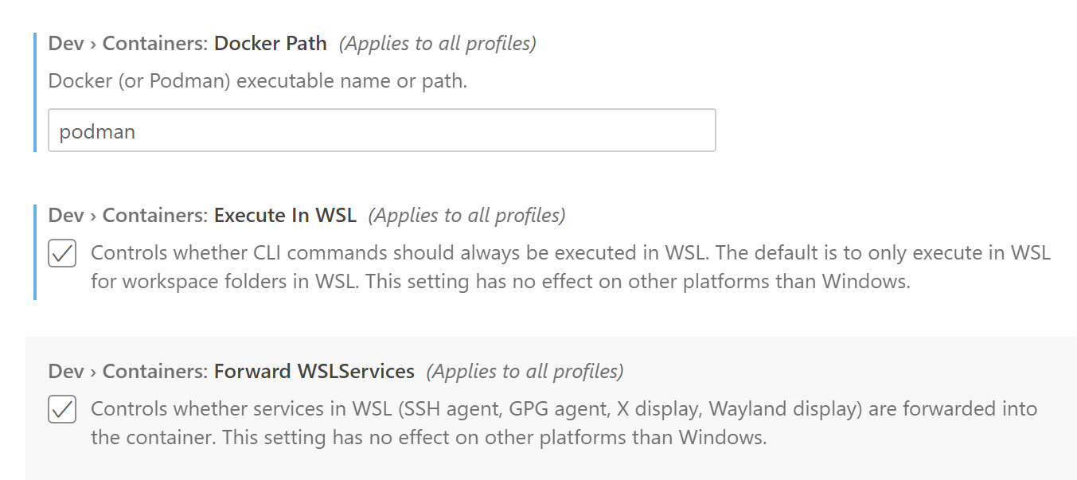
Notes:
Rob make this look nicer vs code is configurable, so if you want to use podman you will need to change some things

Slide 24
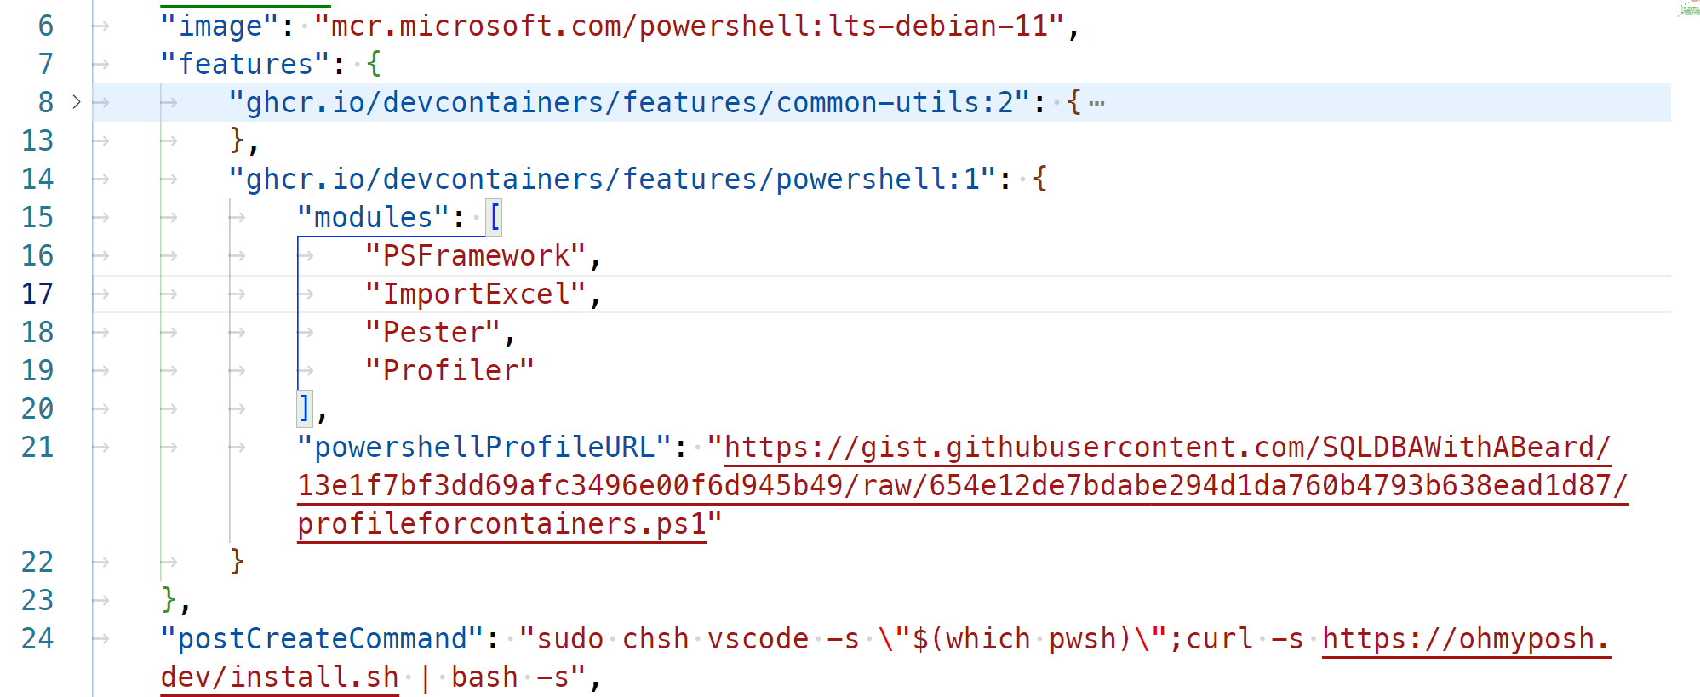
https://github.com/devcontainers/features
Notes:
Development Container Features are self-contained, shareable units of installation code and development container configuration
Features can have options that are documented in the features readme – for example the powershell feature can include modules and a link to a profile file

Slide 25
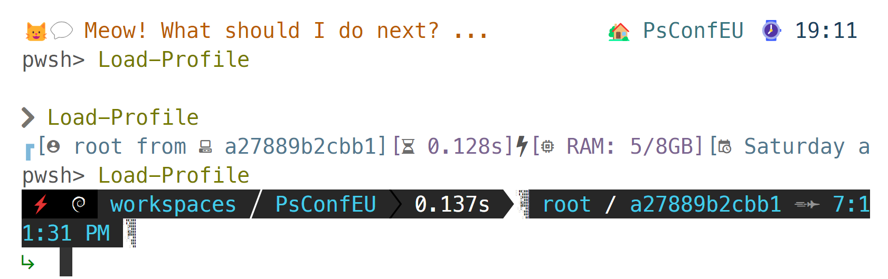

Slide 26

Demos
We love demos..
Notes:
Pre-warm dev containers
PSHTML and ukvelo ones
Uk velo, show devcontainer json, anatomy, features, settings etc – show profile, modules and run the code then PS HTML for more complex with containers and dbachecks for Sampler on top only for complex we just want you to start

Slide 27

GitHub Codespaces: The Power of the Cloud
GitHub Codespaces
GitHub Codespaces is a cloud-based development environment that provides flexibility and accessibility to your development environment, enabling you to code from anywhere.
Advantages of Cloud-based development
Cloud-based development offers several advantages, including scalability, accessibility, and easy collaboration, allowing teams to work together seamlessly.
Creating and Managing your Codespaces
Creating and managing your Codespaces is easy with GitHub. You can easily configure your development environment, access your codespaces from anywhere and share them with your team.
Notes:
GitHub Codespaces takes the power of Dev Containers to the cloud, providing even more flexibility and accessibility to your development environment. We will explore what GitHub Codespaces is, the advantages of cloud-based development, and how to create and manage your Codespaces.

Slide 28

What is GitHub Codespaces?
Cloud-based Development Environment
GitHub Codespaces is a cloud-based development environment that allows developers to access their development environment from any web browser, anywhere, without the need for local hardware.
Seamless Development Experience
GitHub Codespaces provides a seamless development experience by eliminating the need for complex setup instructions or hardware requirements. Developers can focus on coding instead of setting up their development environment.
Notes:
GitHub Codespaces is a cloud-based development environment that allows you to access your development environment from any web browser, anywhere, without your laptop. It provides a seamless development experience, eliminating the need for complex setup instructions or hardware requirements.

Slide 29
Demos
We love demos..

Slide 30
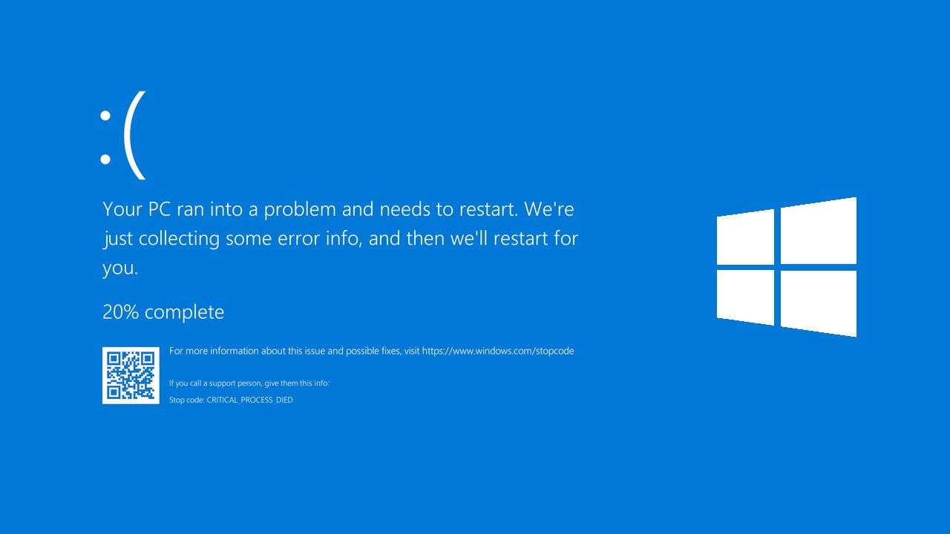
Notes:
Then we will 'borrow' a laptop or probably the ipad and load the codespace demo

Slide 31
Next Level PowerShell Development with Dev Containers and GitHub Codespaces
Jess Pomfret & Rob Sewell

Slide 32

Dev Containers: Simplifying Your Workflow
Dev Containers
Dev Containers are a standardized, isolated environment for your development work that allow you to easily replicate your environment across different machines.
Customization
Dev Containers allow for customization to your specific development needs, providing an optimized and consistent environment.
Integration
Dev Containers can be integrated with essential extensions and settings, allowing for a streamlined development workflow.
Notes:
Dev Containers are a powerful tool that can simplify your workflow by providing a standardized, isolated environment for your development work. We will explore what a Dev Container is, how to customize it to fit your needs, and how to integrate essential extensions and settings.

Slide 33

Customizing Dev Containers
Customizing the Environment
You can customize the Dev Container environment by installing additional packages, libraries, and dependencies required for your development workflow.
Installing Additional Tools and Frameworks
You can install additional tools and frameworks in the Dev Container to enhance your development experience.
Configuring Settings
You can configure settings in the Dev Container to match your workflow, including editor settings, debugging settings, and environment variables.
Notes:
Dev Containers can be customized to fit your specific needs. We will explore how to customize the environment, install additional tools and frameworks, and configure settings to match your workflow.

Slide 34
Demos
We love demos..

Slide 35

Integrating Extensions and Settings
Integration of Extensions
Integrating essential extensions into your development workflow can improve productivity and make your environment more efficient and tailored to your specific needs.
Integration of Settings
Integrating essential settings into your development workflow can help you configure your environment to better suit your specific needs and improve efficiency.
Notes:
Extensions and settings are essential to any development workflow. We will explore how to integrate essential extensions and settings into your Dev Container, ensuring that your environment is always ready for your specific development needs.

Slide 36

Advantages of Cloud-Based Development
Scalability
Cloud-based development provides scalability, allowing developers to scale resources up or down as needed to meet project requirements and optimize costs.
Flexibility
Cloud-based development provides flexibility, allowing developers to work from anywhere, collaborate in real-time, and leverage a wide range of development tools and services.
Accessibility
Cloud-based development provides accessibility, allowing developers to access development environments and resources from any device, anytime, anywhere.
GitHub Codespaces
GitHub Codespaces is a cloud-based development environment that offers a unified development experience accessible to every team member, enhancing collaboration and productivity.
Notes:
Cloud-based development offers many advantages, including scalability, flexibility, and accessibility. We will explore how GitHub Codespaces can enhance your workflow and provide a unified development experience accessible to every team member.

Slide 37

Creating and Managing Codespaces
Setup and Configuration
We will guide you through the process of setting up your environment for Codespaces and configuring your settings and extensions to optimize your workflow.
Managing Codespaces
We will give you tips and tricks on how to manage your Codespaces, including how to customize, delete, and share your Codespaces with others.
Notes:
We will walk you through the process of creating and managing your GitHub Codespaces, from setting up your environment to configuring your settings and extensions. We will also explore some helpful tips and tricks to make the most of your Codespaces.

Slide 38

Conclusion
Dev Containers and GitHub Codespaces offer a unified development experience and accessibility to every team member which can enhance PowerShell scripting capabilities. We encourage you to explore these tools further.
Notes:
Dev Containers and GitHub Codespaces are powerful tools that can streamline your workflow, make development accessible to every team member, and provide a unified development experience. We hope this presentation has inspired you to explore these tools further and discover new ways to enhance your PowerShell scripting experience.

Slide 39

Overview
Dev Container Anatomy
Essential Extensions and Settings.
GitHub Codespaces
Notes:
In this presentation, we will explore the anatomy of a Dev Container, its customization potential, and integrating essential extensions and settings. We will then elevate our discussion to the cloud and showcase the power of GitHub Codespaces. Our mission is to make development accessible to every team member and dismantle entry barriers for newcomers. Dev Container Anatomy
The Dev Container is a powerful tool for customizing your development environment. We will explore its anatomy and learn how to optimize it for your specific needs.
Essential Extensions and Settings
We will explore the essential extensions and settings that can be integrated with your Dev Container to improve your productivity and streamline your workflow.
GitHub Codespaces
We will showcase the power of GitHub Codespaces, a cloud-based development environment that makes development accessible to every team member and dismantles entry barriers for newcomers.

Slide 40
